Slide 1
Chapter 2 Review:
Modeling Data in the Organization
Modern Database Management
10th Edition
Jeffrey A. Hoffer, V. Ramesh,
Heikki Topi
© 2011 Pearson Education, Inc. Publishing as Prentice Hall

Slide 2
E-R Model Constructs
Entities:
  Entity instance–person, place, object, event, concept (often corresponds to a row in a table)
  Entity Type–collection of entities (often corresponds to a table)
Relationships:
  Relationship instance–link between entities (corresponds to primary key-foreign key equivalencies in related tables)
  Relationship type–category of relationship…link between entity types
Attribute–property or characteristic of an entity or relationship type (often corresponds to a field in a table)
Notes:
2

Slide 3
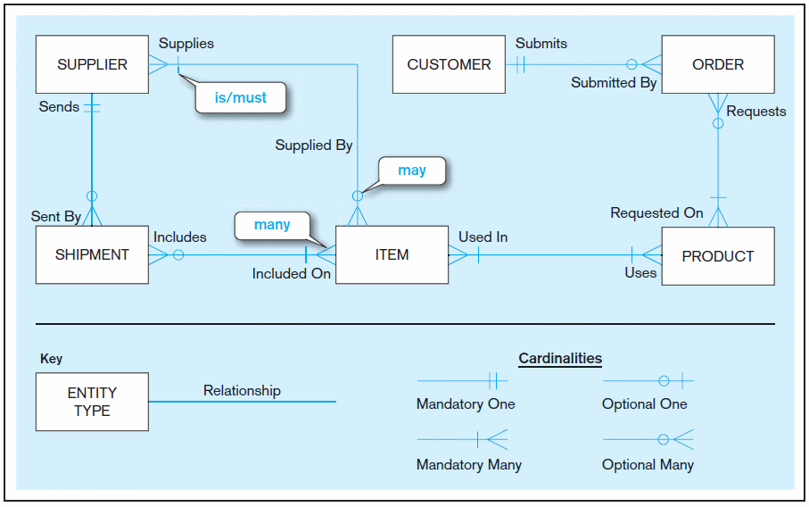
Sample E-R Diagram (Figure 2-1)
Notes:
3

Slide 4
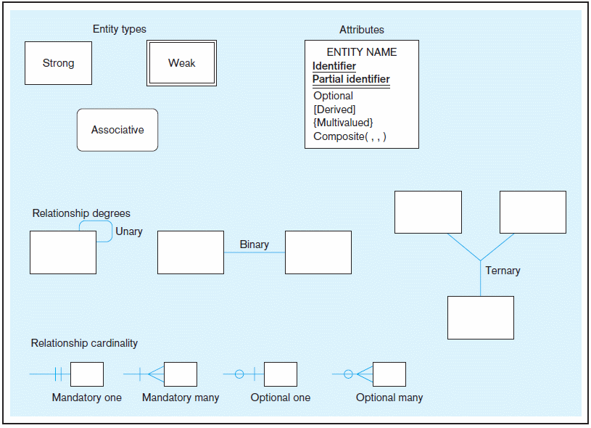
Basic E-R notation (Figure 2-2)
Entity symbols
Attribute symbols
A special entity that is also a relationship
Relationship symbols
Relationship degrees specify number of entity types involved
Relationship cardinalities specify how many of each entity type is allowed
Notes:
8

Slide 5
An Entity…
SHOULD BE:
  An object that will have many instances in the database
  An object that will be composed of multiple attributes
  An object that we are trying to model
SHOULD NOT BE:
  A user of the database system
  An output of the database system (e.g., a report)

Slide 6
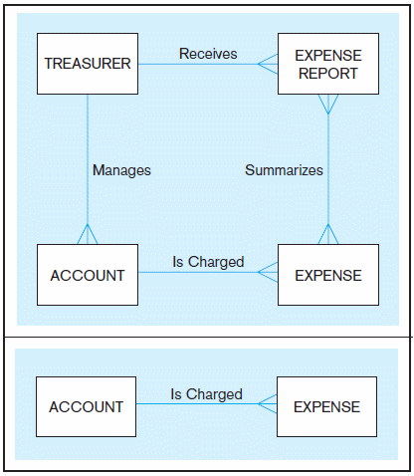
Figure 2-4 Example of inappropriate entities
System
user
System output
Inappropriate entities
Appropriate entities

Slide 7
Attributes
Attribute–property or characteristic of an entity or relationship type
Classifications of attributes:
  Required versus Optional Attributes
  Simple versus Composite Attribute
  Single-Valued versus Multivalued Attribute
  Stored versus Derived Attributes
  Identifier Attributes
Notes:
5

Slide 8
Identifiers (Keys)
Identifier (Key)–an attribute (or combination of attributes) that uniquely identifies individual instances of an entity type
Simple versus Composite Identifier
Candidate Identifier–an attribute that could be a key…satisfies the requirements for being an identifier
Notes:
6

Slide 9
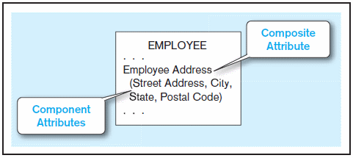
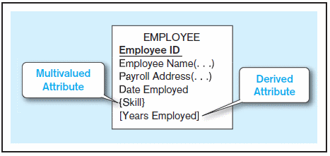
Figure 2-7 A composite attribute
An attribute broken into component parts
Figure 2-8 Entity with multivalued attribute (Skill)
and derived attribute (Years Employed)
Multivalued
an employee can have
more than one skill
Derived
from date employed and current date
Notes:
12

Slide 10
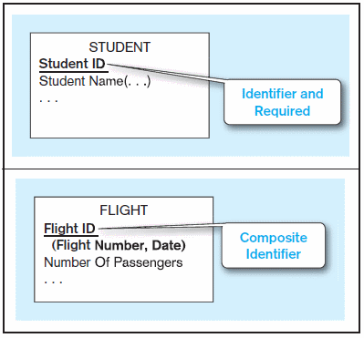


Figure 2-9 Simple and composite identifier attributes
The identifier is boldfaced and underlined
Notes:
14

Slide 11
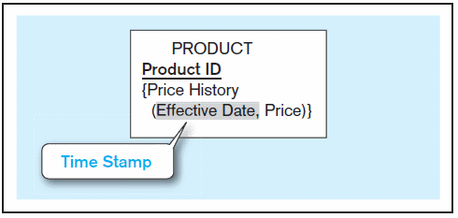
Figure 2-19 Simple example of time-stamping
This attribute is both multivalued and composite
Notes:
37

Slide 12
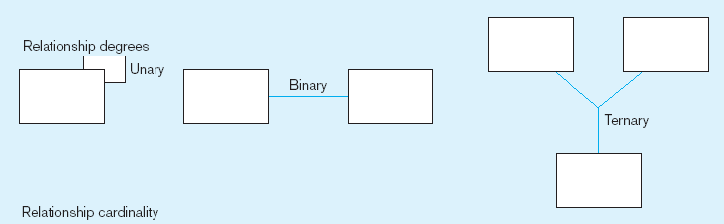
Degree of relationships – from Figure 2-2
Entities of two different types related to each other
One entity related to another of the same entity type
Entities of three different types related to each other
Notes:
8
Degree of relashionships

Slide 13
Cardinality of Relationships
One-to-One
  Each entity in the relationship will have exactly one related entity
One-to-Many
  An entity on one side of the relationship can have many related entities, but an entity on the other side will have a maximum of one related entity
Many-to-Many
  Entities on both sides of the relationship can have many related entities on the other side

Slide 14
Cardinality Constraints
Cardinality Constraints—the number of instances of one entity that can or must be associated with each instance of another entity
Minimum Cardinality
  If zero, then optional
  If one or more, then mandatory
Maximum Cardinality
  The maximum number
Notes:
29

Slide 15
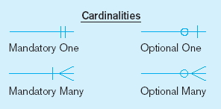
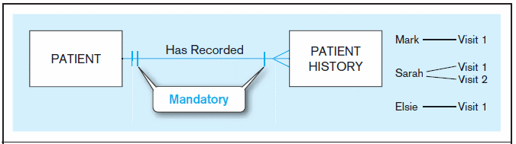
Figure 2-17 Examples of cardinality constraints
a) Mandatory cardinalities
A patient history is recorded for one and only one patient
A patient must have recorded at least one history, and can have many
Notes:
1
Creditability constraints – mandatory or at least one

Slide 16
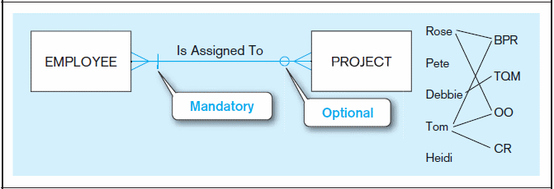
Figure 2-17 Examples of cardinality constraints (cont.)
b) One optional, one mandatory
A project must be assigned to at least one employee, and may be assigned to many
An employee can be assigned to any number of projects, or may not be assigned to any at all
Notes:
1
Cardinality constraints - optional

Slide 17
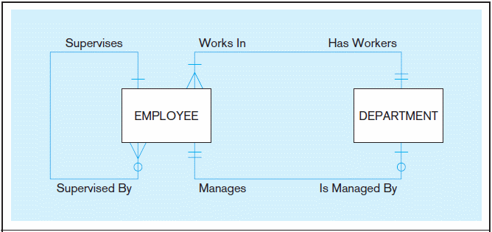
Figure 2-21 Examples of multiple relationships
a) Employees and departments
Entities can be related to one another in more than one way
Notes:
40
Example of multiple relationships between two entities

Slide 18
Strong vs. Weak Entities, and
Identifying Relationships
Strong entity
  exists independently of other types of entities
  has its own unique identifier
    identifier underlined with single line
Weak entity
  dependent on a strong entity (identifying owner)…cannot exist on its own
  does not have a unique identifier (only a partial identifier)
    partial identifier underlined with double line
  entity box has double line
Identifying relationship
  links strong entities to weak entities

Slide 19
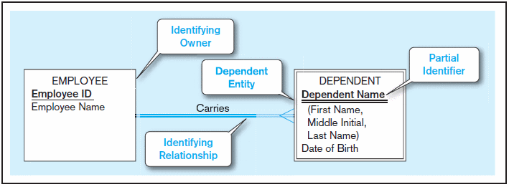
Figure 2-5 Example of a weak identity and its identifying relationship
Strong entity
Weak entity

Slide 20
Associative Entities
An entity–has attributes
A relationship–links entities together
When should a relationship with attributes instead be an associative entity?
  All relationships for the associative entity should be many
  The associative entity could have meaning independent of the other entities
  The associative entity preferably has a unique identifier, and should also have other attributes
  The associative entity may participate in other relationships other than the entities of the associated relationship
  Ternary relationships should be converted to associative entities
Notes:
Associative entity – links entities togethers

Slide 21
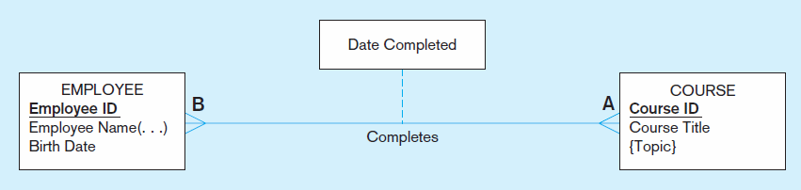
Figure 2-11a A binary relationship with an attribute
Here, the date completed attribute pertains specifically to the employee’s completion of a course…it is an attribute of the relationship
Notes:
20

Slide 22
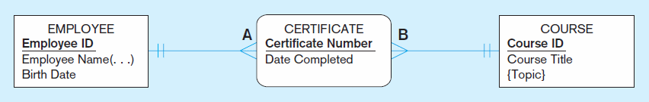
Figure 2-11b An associative entity (CERTIFICATE)
Associative entity is like a relationship with an attribute, but it is also considered to be an entity in its own right
Note that the many-to-many cardinality between entities in Figure 2-11a has been replaced by two one-to-many relationships with the associative entity
Notes:
21
Associative entities can also have attributes

